Slide 1
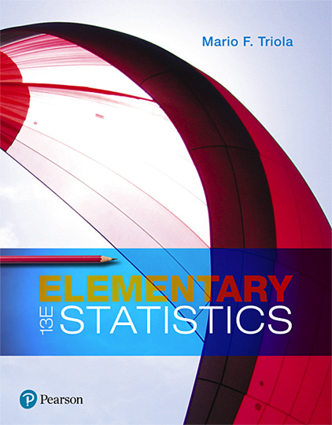
Elementary Statistics
Thirteenth Edition
Chapter 2
Exploring Data with Tables and Graphs
Copyright © 2018, 2014, 2012 Pearson Education, Inc. All Rights Reserved

Slide 2
Exploring Data with Tables and Graphs
2-1 Frequency Distributions for Organizing and Summarizing Data
2-2 Histograms
2-3 Graphs that Enlighten and Graphs that Deceive
2-4 Scatterplots, Correlation, and Regression

Slide 3
Key Concept
Introduce the analysis of paired sample data.
Discuss correlation and the role of a graph called a scatterplot, and provide an introduction to the use of the linear correlation coefficient.
Provide a very brief discussion of linear regression, which involves the equation and graph of the straight line that best fits the sample paired data.

Slide 4
Scatterplot and Correlation (1 of 2)
Correlation
A correlation exists between two variables when the values of one variable are somehow associated with the values of the other variable.
Linear Correlation
A linear correlation exists between two variables when there is a correlation and the plotted points of paired data result in a pattern that can be approximated by a straight line.

Slide 5
Scatterplot and Correlation (2 of 2)
Scatterplot (or Scatter Diagram)
A scatterplot (or scatter diagram) is a plot of paired (x, y) quantitative data with a horizontal x-axis and a vertical y-axis. The horizontal axis is used for the first variable (x), and the vertical axis is used for the second variable (y).

Slide 6
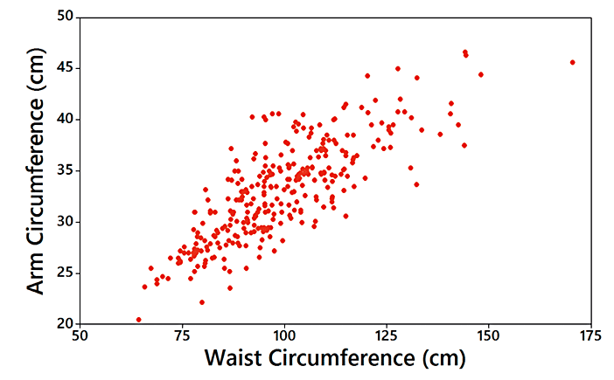
Example: Waist and Arm Correlation (1 of 2)
Correlation: The distinct pattern of the plotted points suggests that there is a correlation between waist circumferences and arm circumferences.

Slide 7
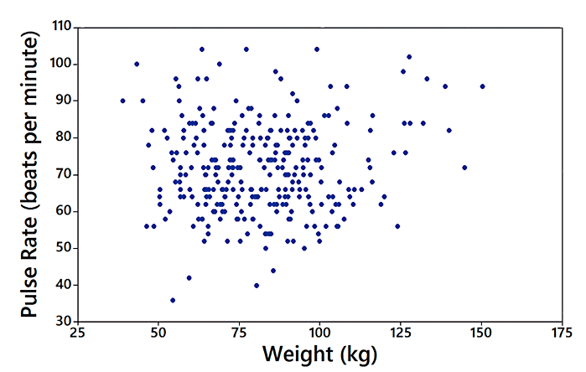
Example: Waist and Arm Correlation (2 of 2)
No Correlation: The plotted points do not show a distinct pattern, so it appears that there is no correlation between weights and pulse rates.

Slide 8
Linear Correlation Coefficient r
Linear Correlation Coefficient r
The linear correlation coefficient is denoted by r, and it measures the strength of the linear association between two variables.

Slide 9
Using r for Determining Correlation
The computed value of the linear correlation coefficient, r, is always between −1 and 1.
If r is close to −1 or close to 1, there appears to be a correlation.
If r is close to 0, there does not appear to be a linear correlation.

Slide 10
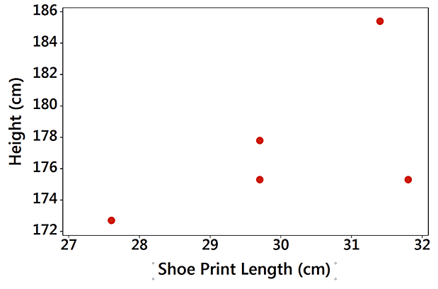
Example: Correlation between Shoe Print Lengths and Heights? (1 of 2)
Shoe Print Length (cm) | 29.7 | 29.7 | 31.4 | 31.8 | 27.6
Height (cm) | 175.3 | 177.8 | 185.4 | 175.3 | 172.7

Slide 11
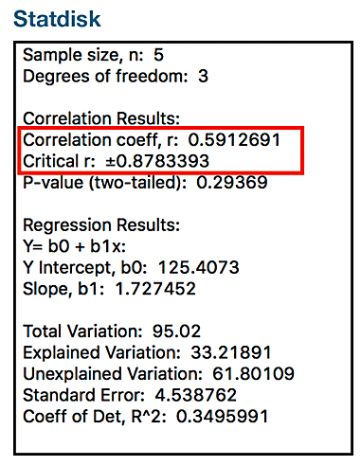
Example: Correlation between Shoe Print Lengths and Heights? (2 of 2)
It isn’t very clear whether there is a linear correlation.

Slide 12
P-Value
P-Value
If there really is no linear correlation between two variables, the P-value is the probability of getting paired sample data with a linear correlation coefficient r that is at least as extreme as the one obtained from the paired sample data.

Slide 13
Interpreting a P-Value from the Previous Example
The P-value of 0.294 is high. It shows there is a high chance of getting a linear correlation coefficient of r = 0.591 (or more extreme) by chance when there is no linear correlation between the two variables.

Slide 14
Interpreting a P-Value from the Example Where n = 5
Because the likelihood of getting r = 0.591 or a more extreme value is so high (29.4% chance), we conclude there is not sufficient evidence to conclude there is a linear correlation between shoe print lengths and heights.

Slide 15
Interpreting a P-Value
Only a small P-value, such as 0.05 or less (or a 5% chance or less), suggests that the sample results are not likely to occur by chance when there is no linear correlation, so a small P-value supports a conclusion that there is a linear correlation between the two variables.

Slide 16
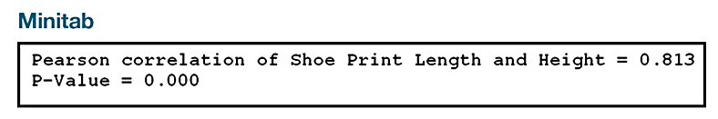
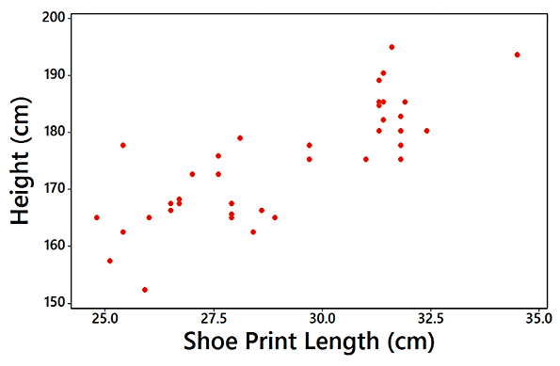
Example: Correlation between Shoe Print Lengths and Heights (n = 40)

Slide 17
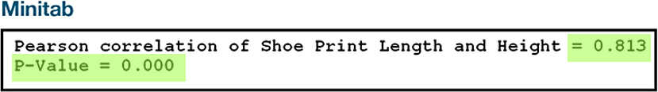
Example: Correlation between Shoe Print Lengths and Heights
The scatterplot shows a distinct pattern. The value of the linear correlation coefficient is r = 0.813, and the P-value is 0.000. Because the P-value of 0.000 is small, we have sufficient evidence to conclude there is a linear correlation between shoe print lengths and heights.

Slide 18
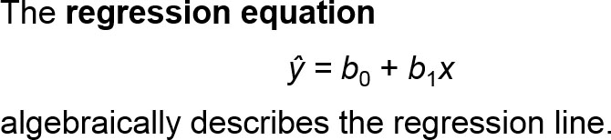
Regression
Regression
Given a collection of paired sample data, the regression line (or line of best fit, or least-squares line) is the straight line that “best” fits the scatterplot of the data.

Slide 19
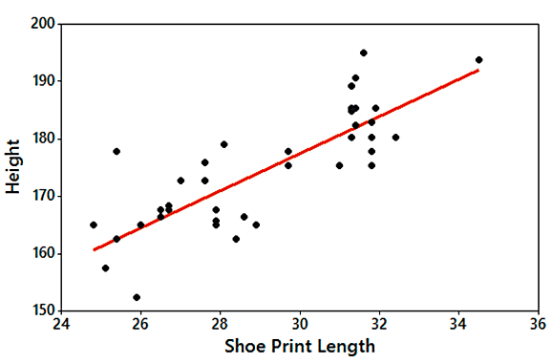
Example: Regression Line (1 of 2)

Slide 20
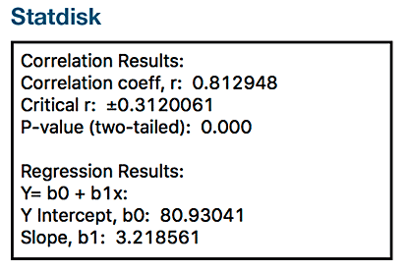
Example: Regression Line (2 of 2)
The general form of the regression equation has a y-intercept of b₀ = 80.9 and slope b₁ = 3.22.
Using variable names, the equation is:
Height = 80.9 + 3.22 (Shoe Print Length)

